Slide 1
Integration Navigator: Goal + Solution
Goal
To make easy to analyze the existing system.
To increase the efficiency of an integration project, and to share the integration effect.
Solution
By visualizing the metadata of the existing system, the issues are discovered intuitively, collecting the essentials interactively.
By simulating integration on metadata level, an integration project is promoted, sharing impact and effect of the integration among all the members.
→ Exploit a “Data Centric Solution”

Slide 2



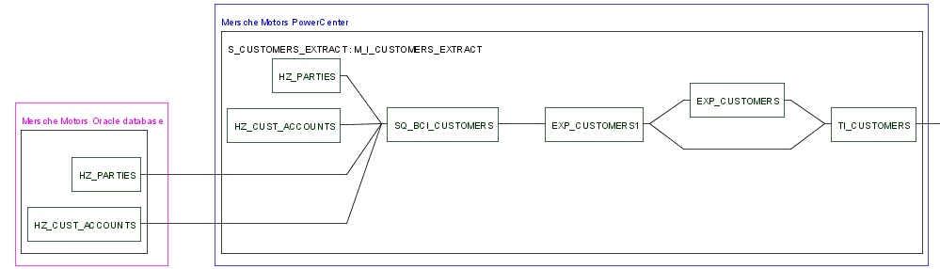
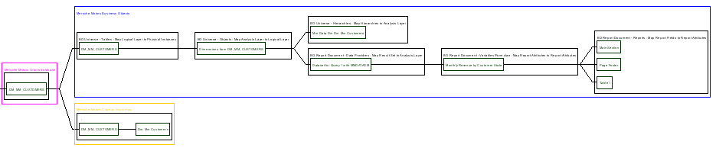
Data Centric Solution
Source
Systems
ETL
Data Warehouse
Business Intelligence
Data Source
Data Warehouse
Data Mart
Contents Manager
Data Source
OLPA Cube
Data Source
Data Source
Data Source
BI Tool
ETL Repository
Metadata Extraction
DWH Repository
BI Repository
Contents Repository
Metadata
Bridge
Metadata Identification (Johosoken/DM)
Extract metadata and calculate relevance
Integrated Metadata Repository
Visualize relevance between data items
Visualization (MERL)

Slide 3
Integration Navigator: Visualization
Objective of Visualization
develop new technology to manage large-scale data repositories
focus on interactive exploration of meta-data information
Provide real-time, interactive support for data integration
Effectiveness and Suitability of Visualization
Interactive visualization is a useful tool
Visual interfaces easier to follow and understand
Visualization leverages and showcases other underlying technologies (from MELCO, MERL, etc….)
NLP-based methods for identifying similar names/entries
Data-mining/learning techniques to aid in integration efforts
Pattern classification and topology extraction algorithms

Slide 4
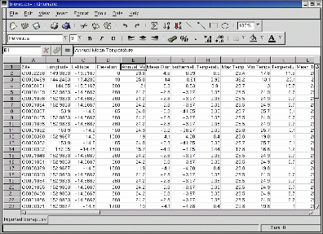
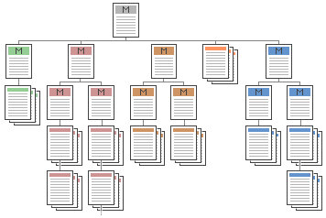
Difficulty of Visualizing Meta-Data
Cannot fully automate the process
User drives the exploration
User brings domain-specific knowledge to the process
Data contains multiple structures
Complicated relationships
Large volume of data
Multiple views of data possible/needed
E.g., database structure, data lineage, table similarity, etc.
Different end users
developers (spreadsheets/macros) vs. business users (reports)

Slide 5
MERL’s Approach to Meta-Data Visualization
Interactive GUI
Emphasis on visual layouts and real-time exploration
Provide multiple linked views of the data
Each view uses a specialized layout algorithm to highlight salient points
Linked views so that user’s actions are visible in all layouts
Changes in one layout influence other layout
Continuous layout management
Layouts are interactive and dynamic to support user exploration
Utilize a mass-spring model for interactivity
Intuitive, easy-to-understand navigation and interactions
MERL’s Technical Advantage
Expertise in interactive graph layout problems
GLIDE [MERL TR1997-015]
More recent work in other visualization techniques
RSVP/Timetunnel, MPV/Movie Recommender,
QueryLines, Temporal Magic Lens, HUGS

Slide 6
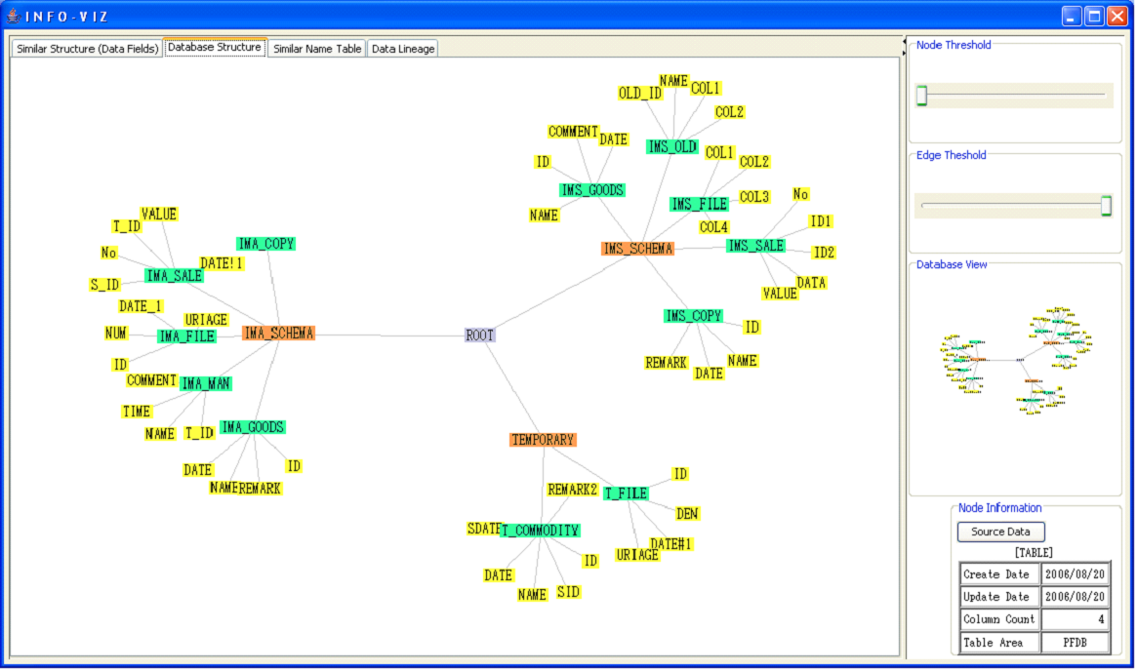
Small Set of Nodes ( About 72 Nodes ) :
Layout
Nodes
Information

Slide 7
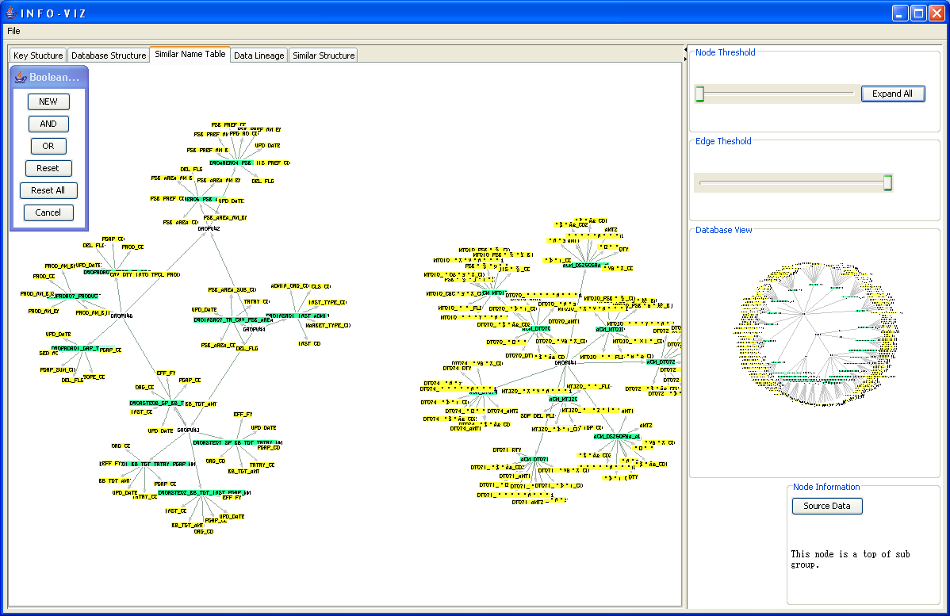
Large Set of Nodes ( About 300 Nodes )
Overview

Slide 8
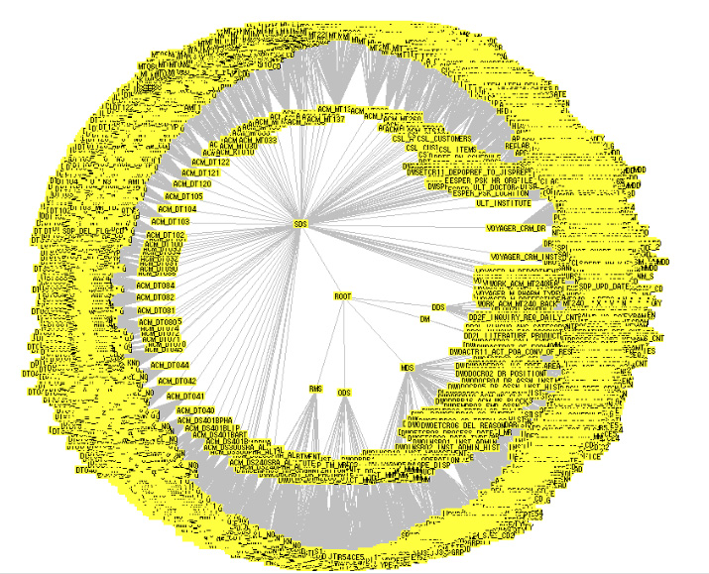
Very Large Set of Nodes (11000)

Slide 9
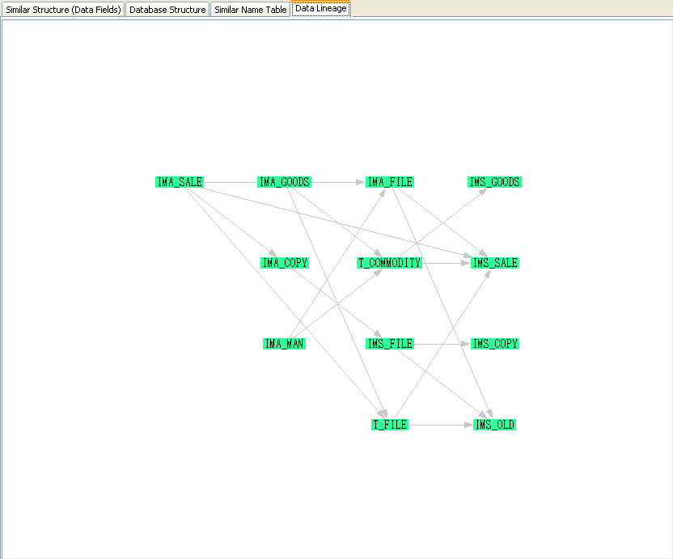
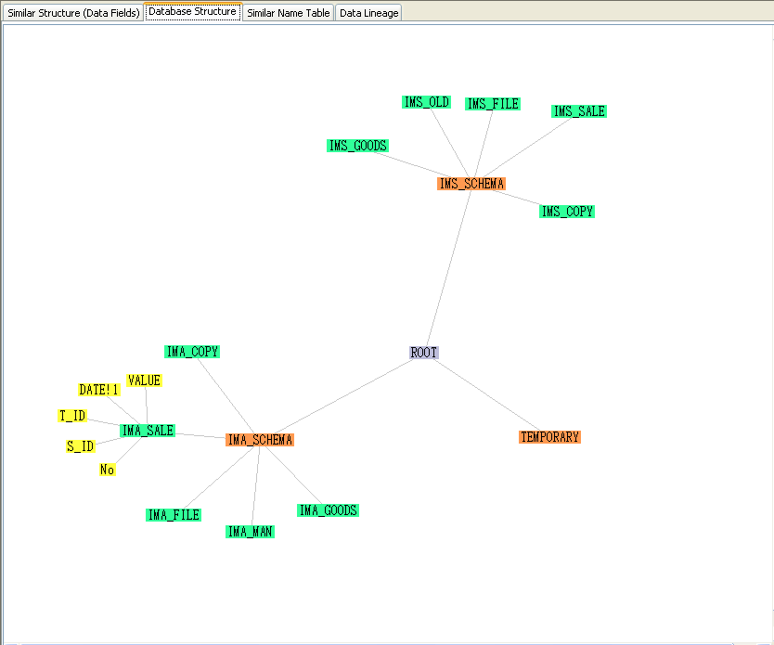
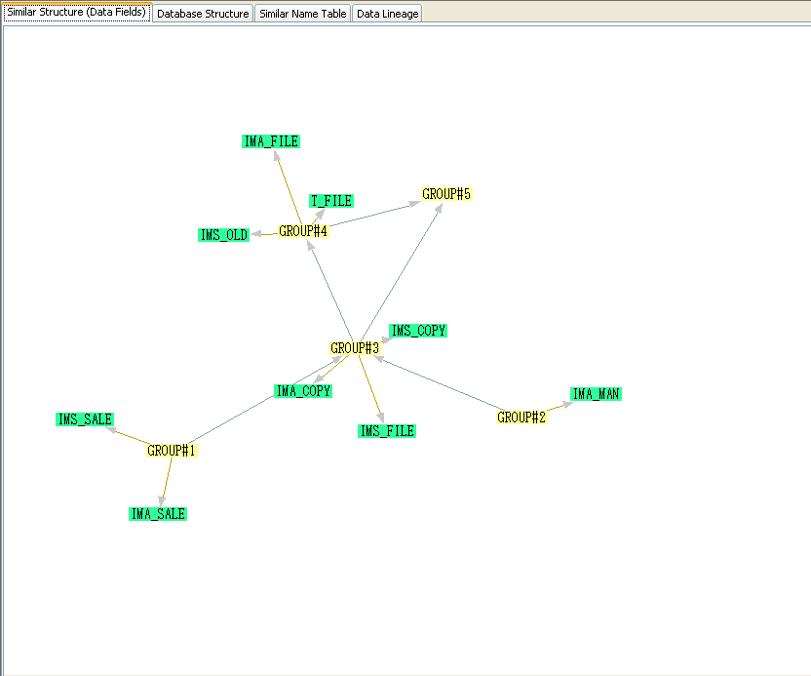
Layout:
Data Lineage Layout
Gives temporal relationship between meta-data
Database Layout
Gives full overview of entire database
Similar Column, Structure, Key Layout
Gives grouped relationship between nodes based on variable parameters

Slide 10
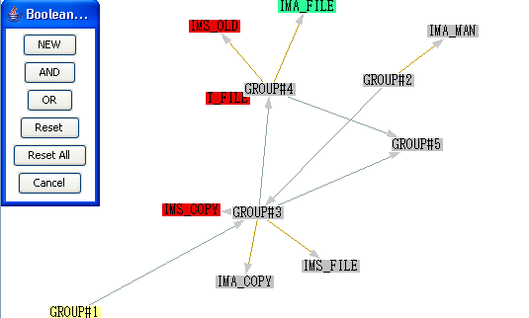
Boolean Operators:
Allows set-theoretic functions on nodes
New set
And set
Or set
Reset current selected
Reset all current and highlighted
Cancel current selected

Slide 11
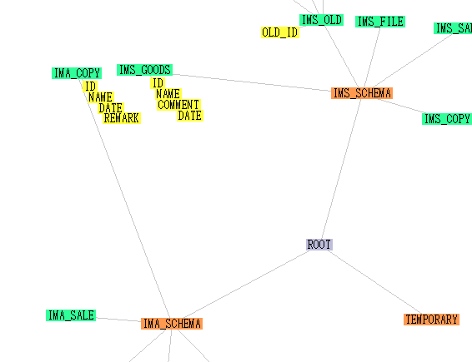
Comparison:
Compares the data in two nodes,

Slide 12
Future Capabilities…
Edit Node Information,
Save Editing back to repository,
Export saved graphs,
Improved Initial Layouts ( VOFs ),

Slide 13
Block Diagram of Integration Navigator:
Visualization （MERL）
Virtual Integration （MERL）
Metadata Identification / Analysis + API（BP）
Data Profiling （BP）
Metadata Extraction （BP）
Language Process （Ongen）
Metadata Management（SuperGlue）
Content Management
Integrated Repository
DB, DWH
ETL

